Slide 1

Defensive distillation against Adversarial attacks for Deep neural networks
Advanced Topics in Machine Learning
Poornima Devi Krishnasamy Karthikeyan
https://arxiv.org/abs/1511.04508

Slide 2
Content
Objective
Dataset Description
Implementation
Fast Gradient Sign attack (FGSM).
Baseline model
Baseline model in the presence of FGSN
Distillation models
Distillation as defence
Implementation of distillation model with FGSM
Results

Slide 3
Objective :
Problem : Neural networks are vulnerable to small, imperceptible perturbations that can cause misclassification.
Goal : Generate an adversarial attack and use a defensive strategy to make classification model robust.
Attack → Generate Fast Gradient Sign Method (FGSM).
Examined the attack impacts on the classification accuracy of the model
Defense → Defensive distillation
Train the student network F1 using soft labels from Teacher F → reduce gradients, encouraging the output to be nearly flat close to training examples → improves classification accuracy against some adversarial attacks during testing.
Notes:
It examines how this attack adversely impacts the classification accuracy of the model.
Adversarial attacks involve the deliberate manipulation of input data to deceive an AI model into making erroneous predictions.
reduces the magnitude of the gradients of the model’s loss with respect to its inputs
It also introduces a modified Defensive Distillation approach
to defend against the FGSM attack to make the classification
models robust.
Use Defensive distillation to reduce the effectiveness of adversarial samples on DNNs. Distilling a network will tend to reduce gradients, encouraging the output to be nearly flat close to training examples.
defensive distillation to smoothen the model learned by a DNN architecture during training, by helping the model generalize better to samples outside of its training dataset.

Slide 4
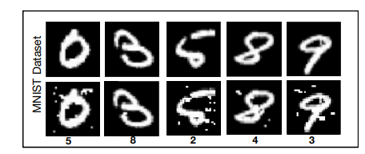
Dataset Description :
MNIST : Contains 70,000 images of handwritten digits (0–9).
Train → 50,000 images
Valid → 10,000 images
Test → 10,000 images
Each image is 28×28 pixels, grayscale, and centered

Slide 5
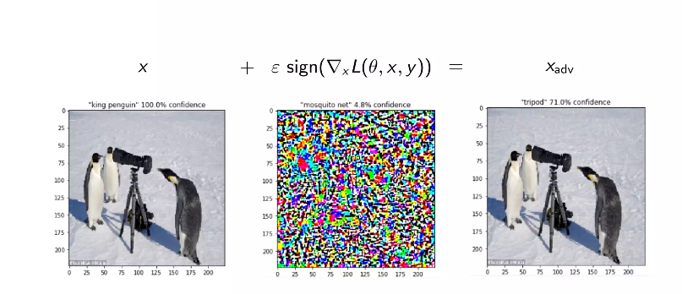
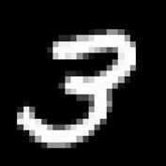


Implementation : Fast Gradient Sign Method
Attack setting :
White box attack → it requires knowledge of the model’s architecture and parameters. Untargeted.
97 % Confident is 3
30 % Confident is 8
crafted to maximize the loss causes misclassification
ϵ controls the intensity of the noise
Goodfellow et al. in 2014 [3].
Larger ε → stronger attack → higher misclassification
Notes:
Sign just takes the direction of the gradient component
Which allows us to take an neural network might recoghnize as one class and switch it up, peturb it and make it look like to the neural network a different class
The method works by computing the gradient of the loss function with respect to the input data and then adjusting the input data in the direction of the sign of this gradient. The perturbation is controlled by a parameter which determines the magnitude of the change applied to the input. The perturbed input is then given to the model, which often results in a misclassification.
Essentialy this is a technique to attack the machine learning model , the number 3 is catoorized as number 3 by the model , if you add a purposely designed noise to image
perturb the input data by adding a small amount of noise based on the gradient of the loss with respect to the input
Untargeted attack aims to cause a model to misclassify an input into any incorrect category, maximizing the model's overall loss
Perturbation added in the direction that maximizes the classification loss
At its core, FGSM is a white-box attack, meaning it requires knowledge of the model’s architecture and parameters
The idea is to The simplicity of FGSM lies in its effectiveness in creating adversarial exam perturb the input data by adding a small amount of noise based on the gradient of the loss with respect to the input .ples with minimal computational cost.
O → parameters of a model
x → input of the model
One of the first attack strategies proposed is Fast Gradient Sign Method (FGSM), developed by Ian Goodfellow et al. in 2014. Given an image, we create an adversarial example by the following expression:
x~=x+ϵ⋅sign(∇xJ(θ,x,y))
The term J(θ,x,y) represents the loss of the network for classifying input image x as label y ; ϵ is the intensity of the noise, and x~ the final adversarial example. The equation resembles SGD and is actually nothing else than that. We change the input image x in the direction of maximizing the loss J(θ,x,y) . This is exactly the other way round as during training, where we try to minimize the loss. The sign function and ϵ can be seen as gradient clipping and learning rate specifically. We only allow our attack to change each pixel value by ϵ . You can also see that the attack can be performed very fast, as it only requires a single forward and backward pass.
The objective is, with the minimum pixel changes to the image x, it
drops the probability pᵢ(x) the most for the ground truth label i, while
increase pⱼ(x) the most for a wrong label j (or a specific target label j).

Slide 6
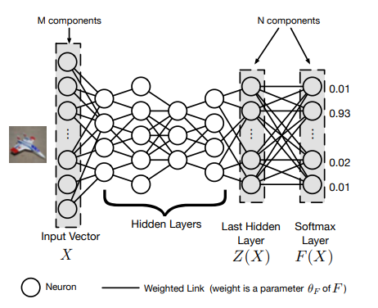


Implementation : Baseline model
Test accuracy 97% with true test images
At Training
Train set Images
3
Input
Objective: minimize the loss

Slide 7
Implementation : Impacts Baseline model in Presence of FGSN
Test accuracy dropped till 30 %
At Inference
Adversarial image
8
Misclassification
Input : Test set + Add perturbations
ϵ is increased from 0 to 0.3
max the loss
Notes:
implement a deep neural network (DNN) — specifically, a convolutional neural network (CNN) — with two convolutional blocks followed by fully connected layers, matching standard architectures used in distillation and adversarial robustness studies [e.g., Paper X].”
We already found the theta that minimizes the loss and we peturb the input image x to max the loss causing the model to misclassify
Training Phase:
[Input Images] → [Model Learns θ] → [Minimize Loss] → Model Saved (θ fixed)
Testing Phase:
[Clean Image '3']
↓
[Compute ∇ₓL → Direction to fool model]
↓
[Add ε·sign(∇ₓL) → Perturbed '3']
↓
[Same Frozen Model → Predicts '8']

Slide 8
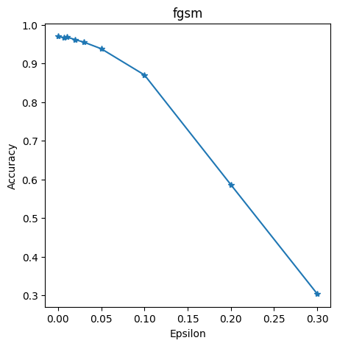
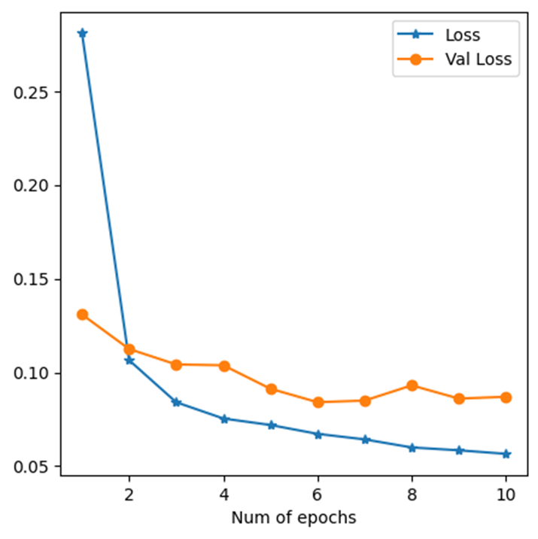
Results : In Presence of FGSM
Test accuracy dropped from 0.97 to 0.30 %
Inference on Test set :
Epsilon | No of correctly classified cases | Total no of cases | Classification accuracy
0 | 9708 | 1000 | 0.970
0.007 | 9668 | 1000 | 0.966
0.01 | 9688 | 1000 | 0.966
0.02 | 9619 | 1000 | 0.961
0.03 | 9554 | 1000 | 0.955
0.05 | 9384 | 1000 | 0.938
0.1 | 8705 | 1000 | 0.870
0.2 | 5863 | 1000 | 0.586
0.3 | 3034 | 1000 | 0.303
Variation of the train and valid loss with no of epochs for the training of the DNN
Effect of the FGSM attack on DNN for different noise levels in absence of defensive distillation
The effect of the FGSM attack on the classification performance of DNN
Notes:
ct of the FGSM attack on the CNN model for different noise levels in absence
of defensive distillation

Slide 9
Implementation :CNN Architecture
Parameter | MNIST Architecture
Epochs | 10
Learning rate | 0.0001
Loss function | Cross entropy
Device | CPU , Google colab
Some training parameters

Slide 10
Distillation models:
Intuition : Transferring knowledge from larger architectures ( Teacher ) to smaller ones ( Student ).
reduce size of DNN architectures ( model compression ) for resource constrained devices (e.g. smartphones)
Robustness
Notes:
motivation behind the knowledge transfer operated by distillation is to reduce the computational complexity of DNN architectures by transferring knowledge from larger architectures to smaller ones.
resource constrained devices (e.g. smartphones) which cannot rely on powerful GPUs to perform computations.

Slide 11
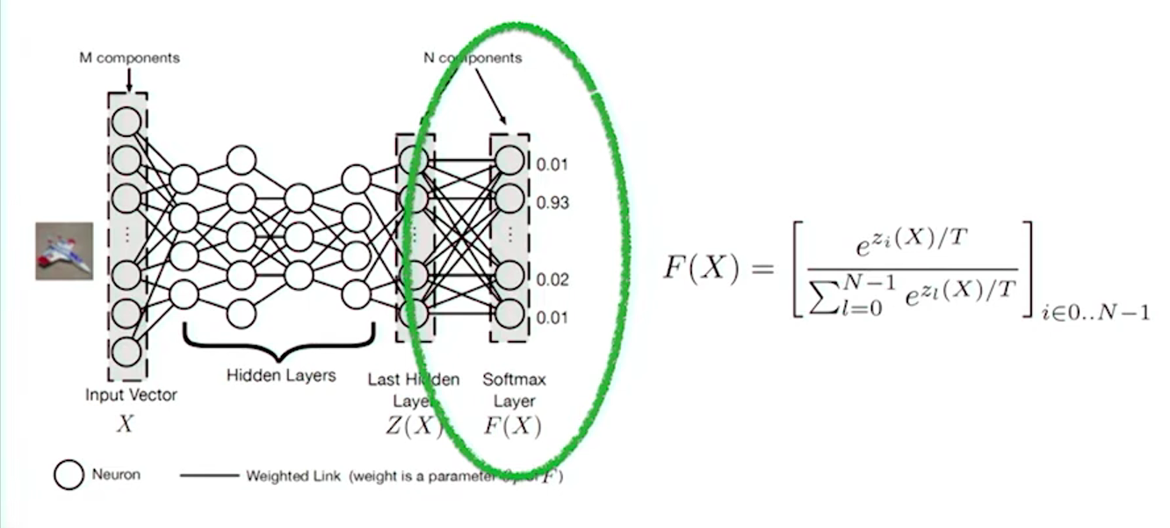

Defense Distillation: DNN Architecture
Main Idea : Instead of transferring knowledge between different architectures, use the knowledge extracted from a DNN to improve its own resilience to adversarial samples.
Teacher F – Student F1– CNN architecture
Teacher - F
T= 100
Train set image
Input
This output is used as input for training student network F1
Notes:
Train the Teacher Model: First, you train a standard, often large, neural network (the “teacher”) on your dataset with the original, hard labels (e.g., “cat,” “dog,” “car”). This is a typical model training process.
Generate Soft Labels with Temperature: Next, you use the trained teacher model to generate predictions for the same training dataset. However, instead of using the standard softmax output, you use a modified version with a “temperature” parameter (T).
Train the Student Model: Finally, you train a second network (the “student”), which can have the same or a different architecture. The crucial difference is that this student model is trained using the soft labels produced by the teacher as its ground truth.
Our intuition is that knowledge extracted by distillation, in
the form of probability vectors, and transferred in smaller
networks to maintain accuracies comparable with those of
larger networks can also be beneficial to improving gener-
alization capabilities of DNNs outside of their training dataset
and therefore enhances their resilience to perturbations. Note
that throughout the remainder of this paper, we assume that
considered DNNs are used for classification tasks and designed
with a softmax layer as their output layer
Figure 1: The extended defensive distillation procedure: (1) the first neural network is trained as usual on one-hot labels, (2) a new labeling vector is defined for each training point by combining the original label information together with the first model’s predictive uncertainty—which is measured by taking several stochastic passes through the model to infer the logits, (3) the distilled model is trained at temperature T ≥ 1 with the new label vectors.

Slide 12
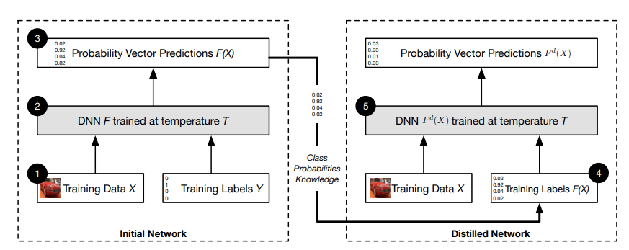
Distillation as Defense: CNN architecture
Soft targets :
Teacher's output probabilities [0.85, 0.05, 0.04, 0.03, 0.01] → richer info than just the correct class.
Teacher - F
Student – F1
Notes:
Defensive distillation to smoothen the model learned by a DNN architecture during training, by helping the model generalize better to samples outside of its training dataset.
To smoothen the model learned by a DNN architecture during training, by helping the model generalize better to samples outside of its training dataset.

Slide 13

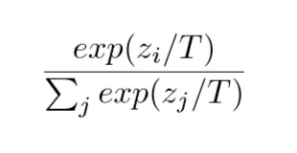

Terms:
Softmax :
raw logits → probability distribution [0.95, 0.02, 0.01, 0.01, 0.01] → Not informative beyond the top prediction.
Temperature ( T ) :
Softens the probability output from softmax [0.85, 0.05, 0.04, 0.03, 0.01]
Higher T → softer, more informative distribution
Notes:
The value of T impacts the distillation , if you have inapproatiate of value of T (which you could destroy your information ) then it not only distills the impurities but also the desired elements of it. This value is found with experimentation so its one of the hyperparamter
Softmax function tends to hide the relative similarity between the other classes → this info is important for distill learning
Defensive distillation to smoothen the model learned by a DNN architecture during training, by helping the model generalize better to samples outside of its training dataset.
The theory is that training on soft labels forces the student model to learn a much smoother function. Adversarial examples, especially those generated by gradient-based methods like FGSM (discussed in Section 4.2.1), exploit sharp, high-gradient areas of the model’s decision boundary. They find the steepest, quickest path to push an input over the line into another class. By training the student model on a smoothed probability landscape, defensive distillation drastically reduces the magnitude of the gradients of the model’s loss with respect to its inputs. If the gradient is near zero, gradient-based attacks are effectively blinded. They receive no clear signal on how to modify the input to change the model’s prediction, rendering them ineffective.
Again, the benefit of using soft-targets F (X) as training
labels lies in the additional knowledge found in probability
vectors compared to hard class labels. This additional entropy
encodes the relative differences between classes. For instance,
in the context of digit recognition developed later in section V,
given an image X of some handwritten digit, model F may
evaluate the probability of class 7 to F7(X) = 0.6 and the
probability of label 1 to F1(X) = 0.4, which then indicates
some structural similarity between 7s and 1s.
Training a network with this explicit relative information
about classes prevents models from fitting too tightly to the
data, and contributes to a better generalization around training
points. Note that the knowledge extraction performed by dis-
tillation is controlled by a parameter: the softmax temperature
T . As described in section II, high temperatures force DNNs to
produce probabilities vectors with large values for each class.
In sections IV and V, we make this intuition more precise
with a theoretical analysis and an empirical evaluation

Slide 14
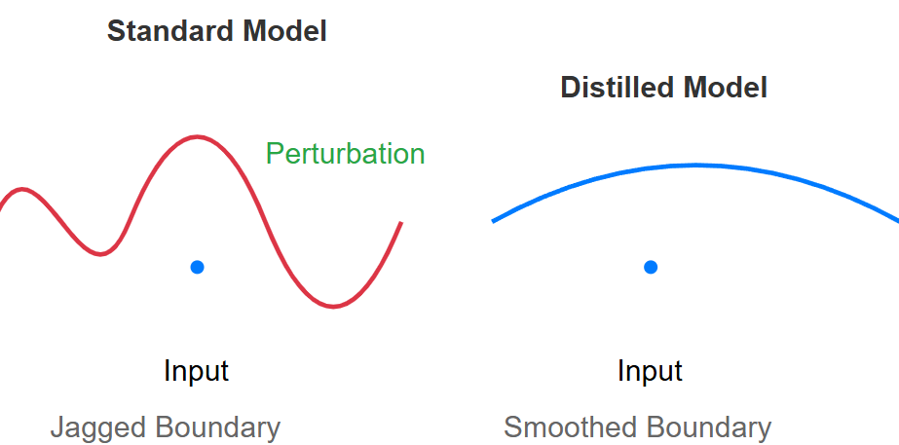
Why it works?
Notes:
The value of T impacts the distillation , if you have inapproatiate of value of T (which you could destroy your information ) then it not only distills the impurities but also the desired elements of it. This value is found with experimentation so its one of the hyperparamter
Softmax function tends to hide the relative similarity between the other classes → this info is important for distill learning
The theory is that training on soft labels forces the student model to learn a much smoother function. Adversarial examples, especially those generated by gradient-based methods like FGSM (discussed in Section 4.2.1), exploit sharp, high-gradient areas of the model’s decision boundary. They find the steepest, quickest path to push an input over the line into another class. By training the student model on a smoothed probability landscape, defensive distillation drastically reduces the magnitude of the gradients of the model’s loss with respect to its inputs. If the gradient is near zero, gradient-based attacks are effectively blinded. They receive no clear signal on how to modify the input to change the model’s prediction, rendering them ineffective.

Slide 15
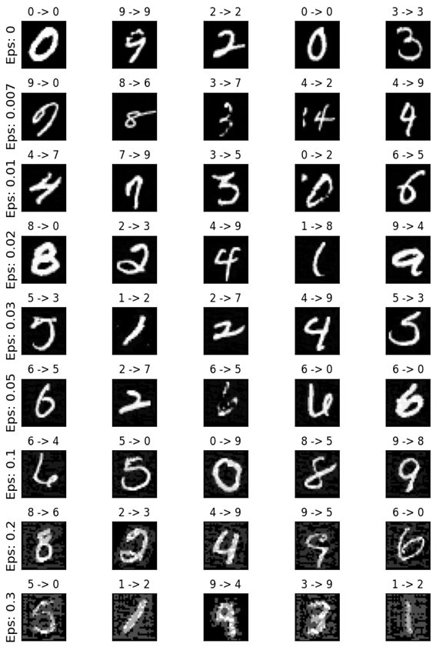
Results : In Presence of FGSM
Classification results under FGSM attack:
Inference on Test set :
Epsilon | No of correctly classified cases | Total no of cases | Classification accuracy
0 | 9708 | 1000 | 0.970
0.007 | 9668 | 1000 | 0.966
0.01 | 9688 | 1000 | 0.966
0.02 | 9619 | 1000 | 0.961
0.03 | 9554 | 1000 | 0.955
0.05 | 9384 | 1000 | 0.938
0.1 | 8705 | 1000 | 0.870
0.2 | 5863 | 1000 | 0.586
0.3 | 3034 | 1000 | 0.303
Effect of the FGSM attack on DNN for different noise levels in absence of defensive distillation
The effect of the FGSM attack on the classification performance of DNN
Notes:
ct of the FGSM attack on the CNN model for different noise levels in absence
of defensive distillation

Slide 16
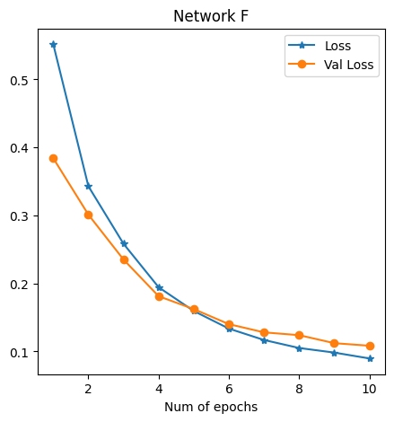
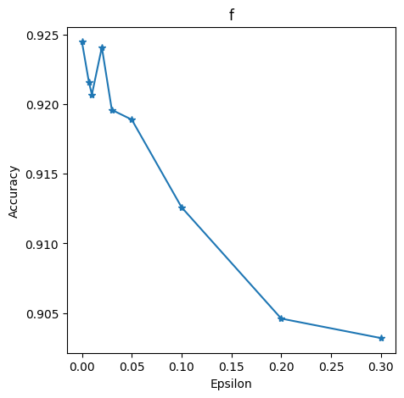
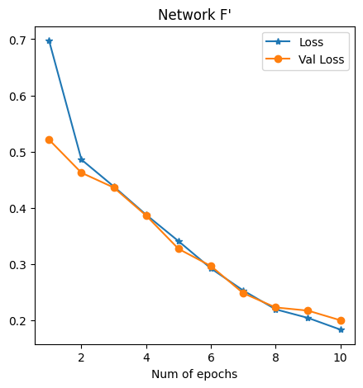
Results : FGSM in Presence of Distillation
Test accuracy only reduced by 2%
gsm
Teacher
Inference on Test set :
Epsilon | No of correctly classified cases | Total no of cases | Classification accuracy
0 | 9245 | 1000 | 0.924
0.007 | 9216 | 1000 | 0.921
0.01 | 9207 | 1000 | 0.920
0.02 | 9241 | 1000 | 0.924
0.03 | 9196 | 1000 | 0.919
0.05 | 9189 | 1000 | 0.918
0.1 | 9126 | 1000 | 0.912
0.2 | 9046 | 1000 | 0.904
0.3 | 9032 | 1000 | 0.903
Variation of the train and valid loss with no. epochs for training distilled DNN(T = 100)
Student
The effect of the FGSM attack on the classification performance of the distilled CNN model
The effect of the FGSM attack on the classification performance of the distilled CNN model
Notes:
or both architectures and provides exact figures. In other
words, the rate plotted is the number of adversarial sample
targets that were reached. Two interesting observations can be
made: (1) increasing the temperature will generally speaking
make adversarial sample crafting harder, and (2) there is an
elbow point after which the rate largely remains constant
(≈ 0% for MNIST and ≈ 5% for CIFAR10).

Slide 17
Results : FGSM in Presence of Distillation
Test accuracy only reduced by 2%
Inference on Test set :
Epsilon | No of correctly classified cases | Total no of cases | Classification accuracy
0 | 9245 | 1000 | 0.924
0.007 | 9216 | 1000 | 0.921
0.01 | 9207 | 1000 | 0.920
0.02 | 9241 | 1000 | 0.924
0.03 | 9196 | 1000 | 0.919
0.05 | 9189 | 1000 | 0.918
0.1 | 9126 | 1000 | 0.912
0.2 | 9046 | 1000 | 0.904
0.3 | 9032 | 1000 | 0.903
Observation : The distilled network seems to be robust in defending against the adversarial samples created by the FGSM attack. The classification accuracy of the distilled network even at 30% noise level is found to be as high as 0.903.
The effect of the FGSM attack on the classification performance of DNN

Slide 18
Thank you !
https://arxiv.org/abs/1511.04508

Slide 19
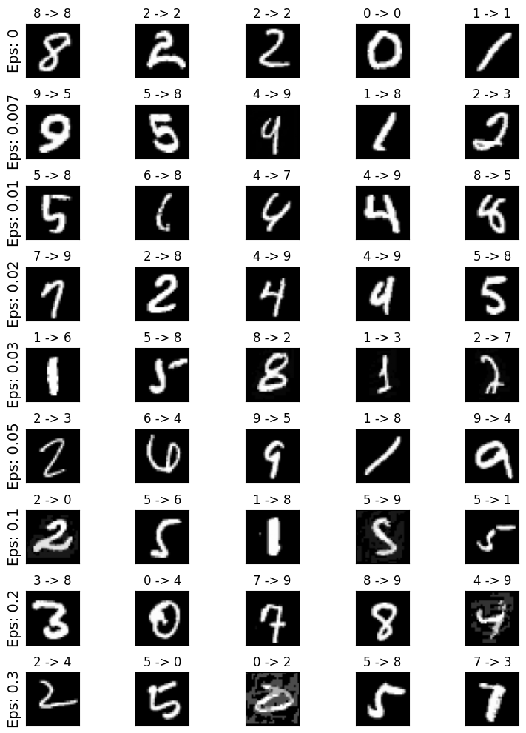
Results : FGSM in Presence of Distillation
Classification results distillation with FGSM:
Test accuracy only reduced by 2%
Inference on Test set :
Epsilon | No of correctly classified cases | Total no of cases | Classification accuracy
0 | 9245 | 1000 | 0.924
0.007 | 9216 | 1000 | 0.921
0.01 | 9207 | 1000 | 0.920
0.02 | 9241 | 1000 | 0.924
0.03 | 9196 | 1000 | 0.919
0.05 | 9189 | 1000 | 0.918
0.1 | 9126 | 1000 | 0.912
0.2 | 9046 | 1000 | 0.904
0.3 | 9032 | 1000 | 0.903
The effect of the FGSM attack on the classification performance of DNN
8-> 8
Distilled prediction → Distilled prediction with FGSM

Slide 20
Why distillation fails?
A defense that makes a model harder to attack is not the same as a defense that makes a model more robust
Notes:
True robustness comes from learning better representations, not from hiding the attack surface. When your tools fail, question whether the defense is real or just an illusion.
If the gradient is near zero, gradient-based attacks are effectively blinded. They receive no clear signal on how to modify the input to change the model’s prediction, rendering them ineffective

Slide 21
Limitation:
Student model is constrained by teacher model rules → limited ability to reject attacks.
Vulnerable to poisoning attacks (attacker corrupts training data).
Drawbacks are downplayed in the paper.

Slide 22
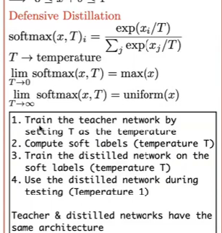
Notes:
The key to the adaptation of distillation to adversarial defense is a special parameter, the temperature T, that controls the variability of the SoftMax outputs. Higher values of T reduce the value of the maximum SoftMax probabilities produced by the DNNs and smooth the decision surface of the trained model. This smoother loss terrain substantially reduces gradients around the natural samples, so that adversarial examples are more easily classified. The authors found that a value of T = 20 worked well for distillation defense. After the distilled network is trained, T is set to 1.0 for classification

Slide 23
Results : FGSM in Presence of Distillation
Results tell that FGSM attack reduces the test accuracy from 97.08% to 24.84% with epsilon from 0 to 0.3.
Results for Defensive distillation tells that FGSM attack reduces test accuracy from 90.33% to 88.01% epsilon from 0 to 0.3.
we can say that defensive distillation for the proposed network with temp of 100 was successful and it only reduced ~2% of test accuracy for max epsilon of 0.3.

Slide 24
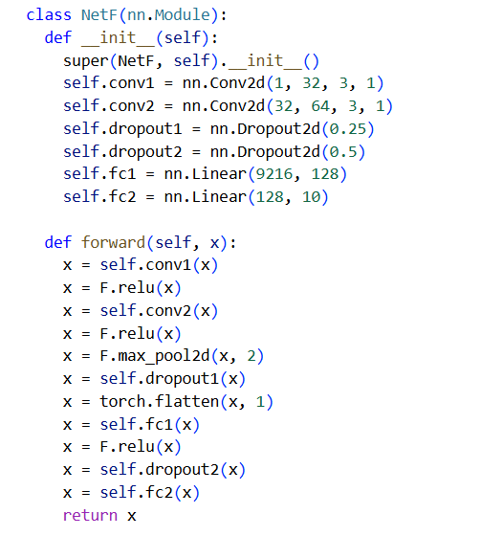
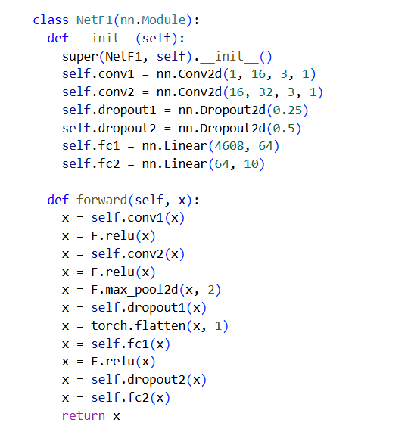
Implementation : DNN architecture with distillation
Defense training: instead of transferring knowledge between different architectures, we propose to use the knowledge extracted from a DNN to improve its own resilience to adversarial samples.
Teacher - F
Student – F1
Temp = 100
epochs=10
Epsilons=[0,0.007,0.01,0.02,0.03,
0.05,0.1,0.2,0.3]
output = F.log_softmax(output / Temp, dim=1)

Slide 25
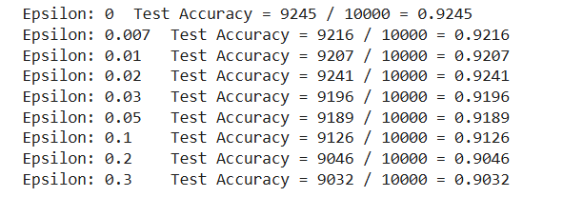
Results : FGSM in Presence of Distillation

Slide 26
Methodology : Terms
Soft targets :
Teacher's output probabilities [0.85, 0.05, 0.04, 0.03, 0.01] → richer info than just the correct class.
Hard targets :
One-hot true labels [1, 0, 0, 0]) → standard classification loss
Notes:
knowledge distillation, alpha (α) is a hyperparameter that controls the balance between two loss functions: the student's loss on the ground truth labels (often cross-entropy) and the distillation loss (often KL divergence) comparing the student's soft predictions with the teacher's soft predictions. Essentially, it determines how much emphasis is placed on learning from the teacher's "knowledge" versus learning from the true labels.

Slide 27
Results : FGSM in Presence of Distillation

Slide 28
Robustness :
Robustness : A network is robust if it returns output on all inputs.
Impractical: the input space is too large to be covered
Local Robustness (informal): A learning model is locally-robust if it returns the correct output on inputs similar to inputs in the training set.
This was believed to be evident by having high accuracy on the test set

Slide 29
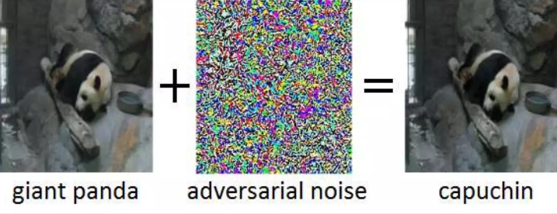
Adversarial Examples:
Can we trust them ?

